Slide 1
Divide and Conquer
Notes:
To create Em dash above headline:
Same size and weight as the headline and set using a soft return.
PC: Em dash (—): Alt+Ctrl+ - (minus)
Mac: Em dash (—): Shift+Alt/Option+hyphen

Slide 2
Learning objectives
Understand the divide-and-conquer algorithmic approach.
Understand and apply this approach to finding and element in a rotated sorted array
Understand and apply Merge Sort and Quick Sort.
Understand and apply divide-and-conquer to the convex hull problem.

Slide 3
Agenda
Overview of the Divide-and-Conquer approach
Sorting techniques: Merge Sort & Quick Sort
Quick Hull algorithm

Slide 4
1. Overview
Notes:
To create Em dash above headline:
Same size and weight as the headline and set using a soft return.
PC: Em dash (—): Alt+Ctrl+ - (minus)
Mac: Em dash (—): Shift+Alt/Option+hyphen

Slide 5
Divide and Conquer
Strategy:
Divide the problem instance into smaller subproblems.
Solve each subproblem (recursively).
Combine smaller solutions to solve the original instance.

Slide 6
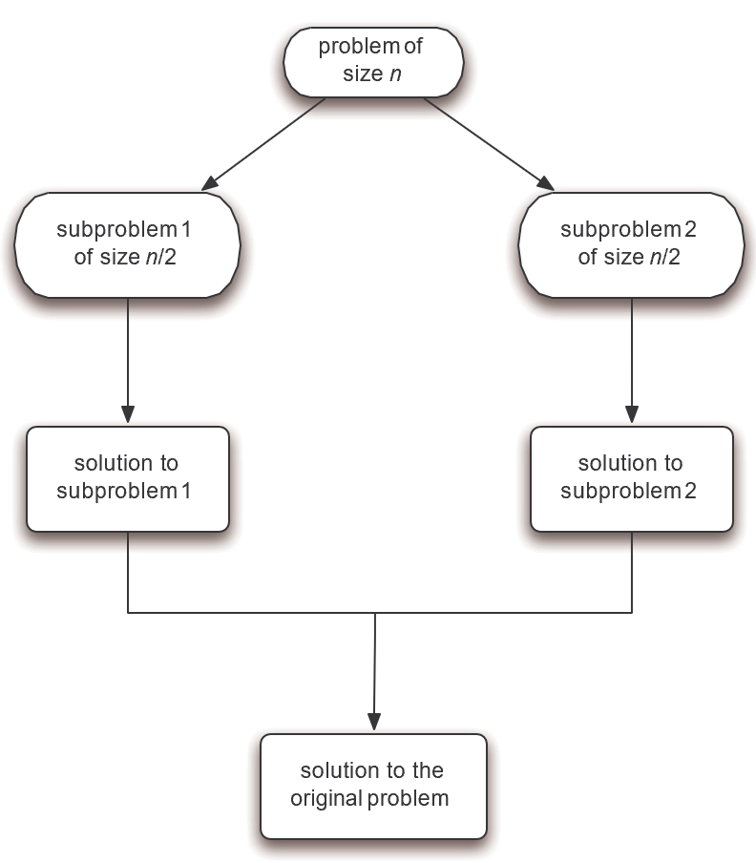
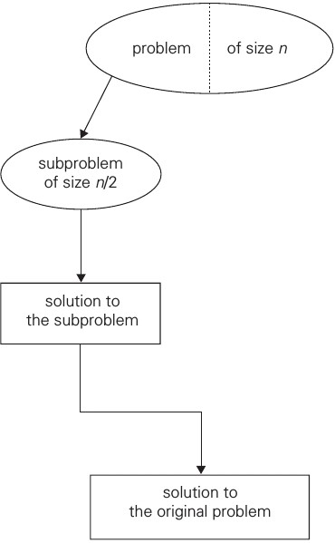
Compare with Decrease-by-a-constant-factor

Slide 7
2a. Find an element in a sorted and rotated array
Notes:
To create Em dash above headline:
Same size and weight as the headline and set using a soft return.
PC: Em dash (—): Alt+Ctrl+ - (minus)
Mac: Em dash (—): Shift+Alt/Option+hyphen

Slide 8
Searching in a Rotated Sorted Array
First option is to find pivot point and then call binary search on the appropriate sub-array. Alternatively we can search an element in one pass of Binary Search.
1) Find middle point mid = (l + h)/2
2) If key is present at middle point, return mid
3) Else If arr[l..mid] is sorted
a) If key to be searched lies in range arr[l] to arr[mid], recur for arr[l..mid].
b) Else recur for arr[mid+1..h]
4) Else (arr[mid+1..h] must be sorted)
a) If key to be searched lies in range arr[mid+1] to arr[h], recur for arr[mid+1..h].
b) Else recur for arr[l..mid]
What is the flaw in both of these algorithms?
Notes:
Do not work for 2,2,0,2,2,2,2,2

Slide 9
2b. Merge Sort
Notes:
To create Em dash above headline:
Same size and weight as the headline and set using a soft return.
PC: Em dash (—): Alt+Ctrl+ - (minus)
Mac: Em dash (—): Shift+Alt/Option+hyphen

Slide 10
Merge Sort
Idea:
We recursively divide an array (we want to sort) into halves, until we reach single element partitions.
We then recursively merge the partitions, where we have a process that maintains sorting after partitions are merged.
When we finally merge the last two partitions, we have a sorted array.

Slide 11
Merge Sort Example
Compares
15
21
1
25
12
6
8
3
5
19
10
18
0

Slide 12
Merge Sort Example
Compares
15
21
1
25
12
6
8
3
5
19
10
18
0

Slide 13
Merge Sort Example
Compares
15
21
1
25
12
6
8
3
5
19
10
18
0

Slide 14
Merge Sort Example
Compares
15
21
1
25
12
6
8
3
5
19
10
18
0

Slide 15
Merge Sort Example
Compares
15
21
1
25
12
6
8
3
5
19
10
18
0

Slide 16
Merge Sort Example
Compares
15
1
21
25
12
6
8
3
5
19
10
18
1

Slide 17
Merge Sort Example
Compares
15
1
21
25
6
12
8
3
5
19
10
18
2

Slide 18
Merge Sort Example
Compares
15
1
21
25
6
12
8
3
5
19
10
18
3

Slide 19
Merge Sort Example
Compares
15
1
21
25
6
12
8
3
5
19
10
18
4

Slide 20
Merge Sort Example
Compares
1
15
21
25
6
12
8
3
5
19
10
18
6

Slide 21
Merge Sort Example
Compares
1
15
21
6
12
25
8
3
5
19
10
18
8

Slide 22
Merge Sort Example
Compares
1
15
21
6
12
25
3
5
8
19
10
18
10

Slide 23
Merge Sort Example
Compares
1
15
21
6
12
25
3
5
8
10
18
19
12

Slide 24
Merge Sort Example
Compares
1
6
12
15
21
25
3
5
8
10
18
19
17

Slide 25
Merge Sort Example
Compares
1
6
12
15
21
25
3
5
8
10
18
19
20

Slide 26
Merge Sort Example
Compares
1
3
5
6
8
10
12
15
18
19
21
25
30

Slide 27
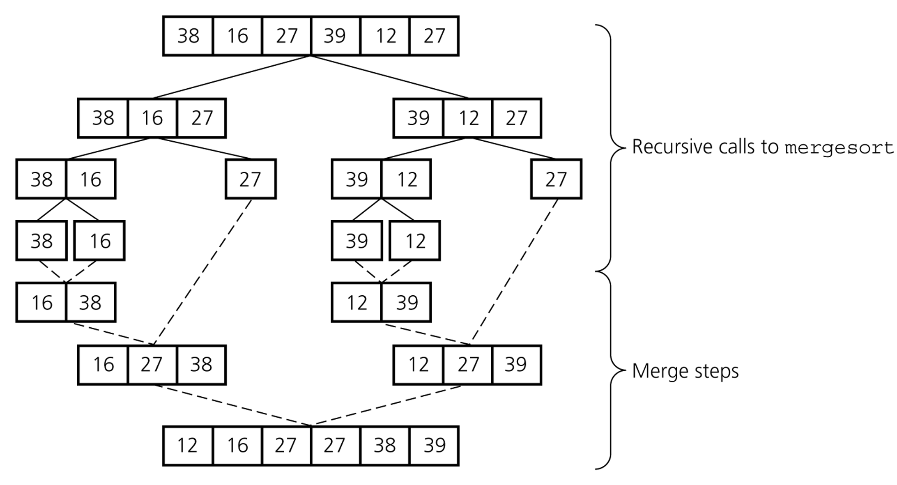
Merge Sort – Example 2

Slide 28
Merge Sort demo
https://visualgo.net/bn/sorting

Slide 29
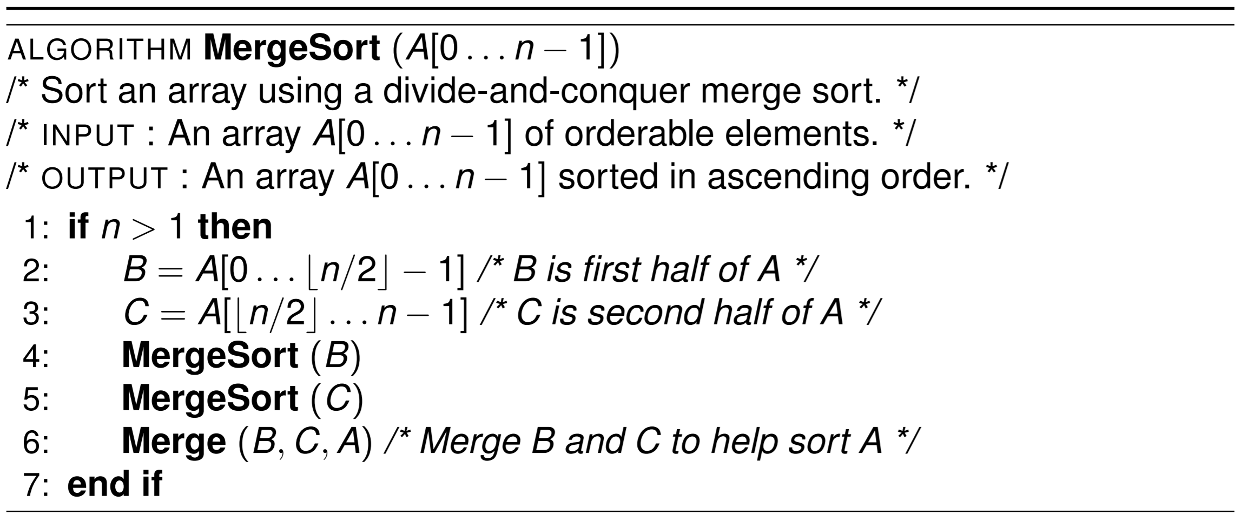
Merge Sort Algorithm

Slide 30
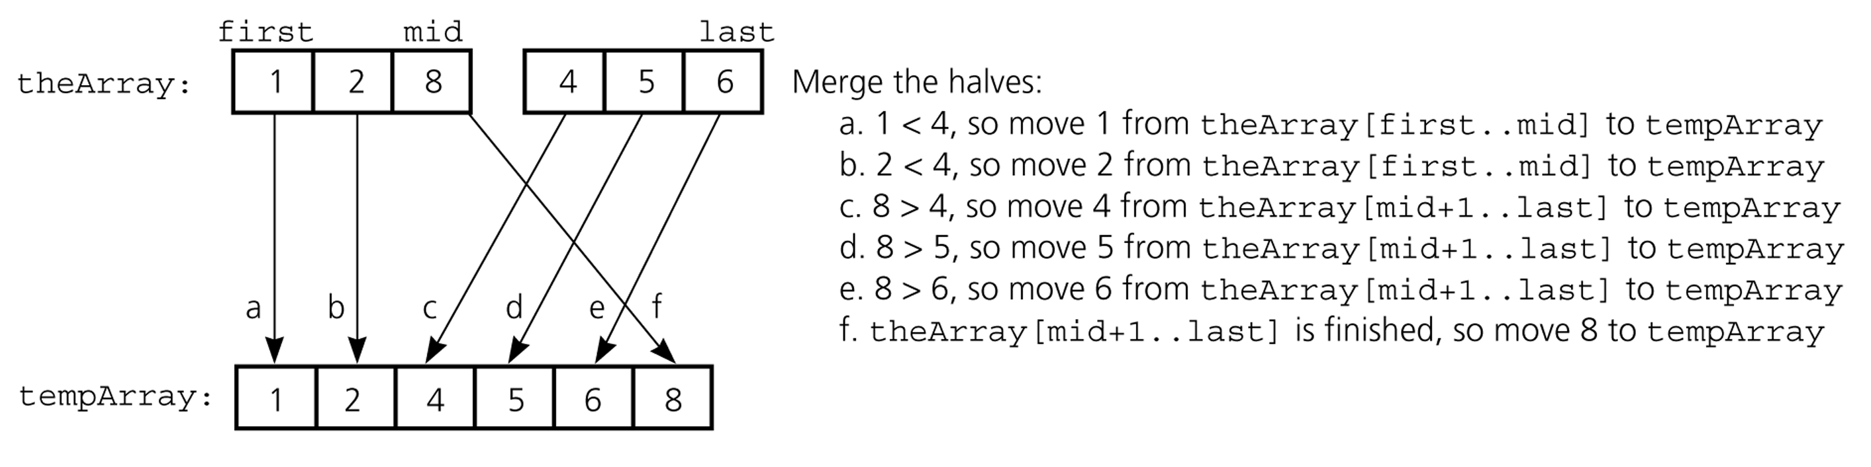
Mergesort – Analysis of Merge
A worst-case instance of the merge step in mergesort

Slide 31
Analysis of Merge (cont.)
Merging two sorted arrays of size k
Best-case:
All the elements in the first array are smaller (or larger) than all the elements in the second array.
The number of moves: 2k + 2k
The number of key comparisons: k
Worst-case:
The number of moves: 2k + 2k
The number of key comparisons: 2k-1
0 k-1
0 k-1
 | ......
 | ......
0 2k-1
 | ......

Slide 32
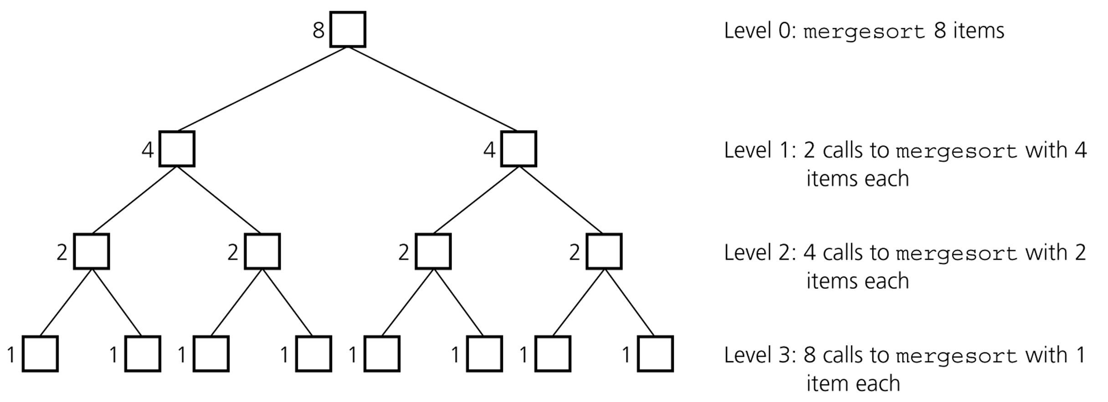
Mergesort - Analysis
Levels of recursive calls to mergesort, given an array of eight items

Slide 33
Merge Sort Analysis
n = n
C(n)
2(n/2) = n
C(n/2)
C(n/2)
h = 1 + logn
4(n/4) = n
C(n/4)
C(n/4)
C(n/4)
C(n/4)
…
…
Θ(n)
Notes:
Takes logn divisions by 2 to make the recursion tree; tree’s height = 1 + logn (plus the root)
C(n) = max number of comparisons

Slide 34
Mergesort – Analysis
Merge sort is extremely efficient algorithm with respect to time
Both worst case and average cases are O (n * log₂n )
But, merge sort requires an extra array whose size equals to the size of the original array
If we use a linked list, we do not need an extra array
But, we need space for the links
And, it will be difficult to divide the list into half ( O(n) )

Slide 35
Merge() in Merge Sort
Given two sorted subarrays B and C, we want to merge them together to form a sorted array A.
Consider first element of each subarray, i.e., B[0] and C[0].
Compare them. Copy the smaller one to A[0], and increment current pointer of subarrays that has smaller element and A.
Repeat until one of subarrays is empty. Then copy the rest of the other subarray to A.

Slide 36
Comments on Merge Sort
Guarantees O(n*logn) time complexity, regardless of the original distribution of data – this sorting method is insensitive to the data input.
The main drawback in this method is the extra space required for merging two partitions/sub-arrays, e.g., B and C from pseudo-code.
Merge sort is a stable sorting method.

Slide 37
2c. Quick Sort

Slide 38
Quick Sort
Motivation:
Merge sort has consistent behaviour for all inputs – what if we seek an algorithm that is fast for the average case?
Quick sort is such a sorting algorithm, often the best practical choice in terms of efficiency because of its good performance on the average case.
Quick sort is a divide and conquer algorithm.

Slide 39
Quick Sort – Idea
Select an element from the array for which, we hope, about half the elements will come before and half after in a sorted array. Call this element the pivot.
Partition the array so that all elements with a value less than the pivot are in one subarray, and larger elements come in the other subarray.
Swap pivot into position of array that is between the partitions.

Slide 40
Quick Sort – Idea
Recursively apply the same procedure on the two subarrays separately.
Terminate when only subarrays are of one element.
When terminate, because we do things in-place, the resulting array is sorted.

Slide 41
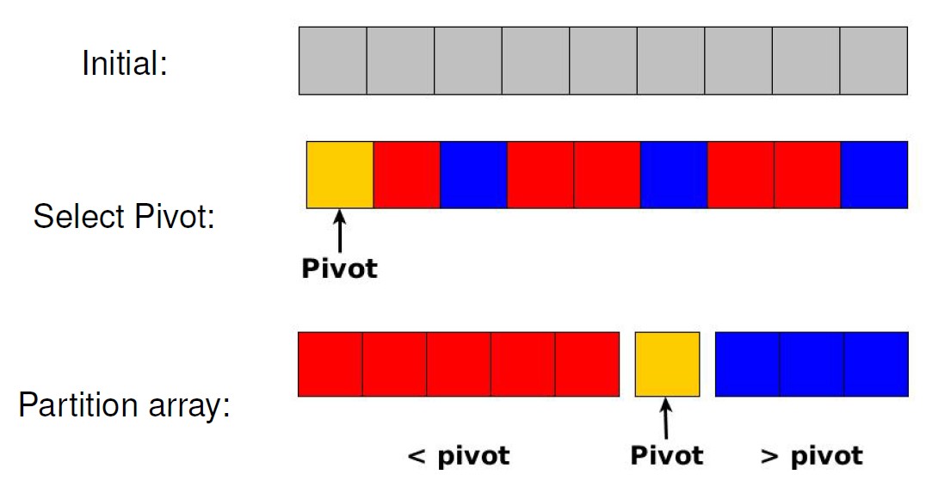
Quick Sort – Idea

Slide 42
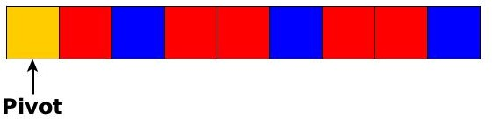
Quick Sort (Hoare partition scheme)
How to efficiently partition the elements less than pivot on one side, greater than partition on the other?
We basically run two linear scans from the front and back of the array, and swap elements that are out of place (i.e., will be on the wrong side of the eventual place of pivot)
red = small / left side
blue = large / right side

Slide 43
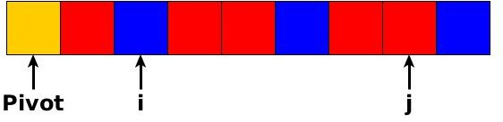
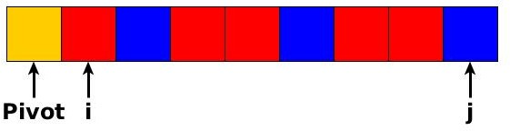
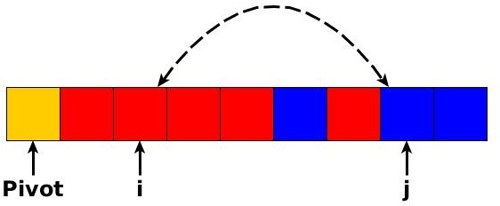
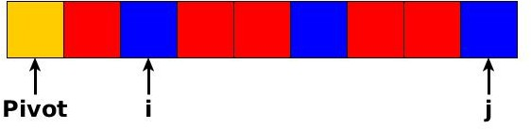
Quick Sort (Hoare partition scheme)
red = small / left side
blue = large / right side

Slide 44
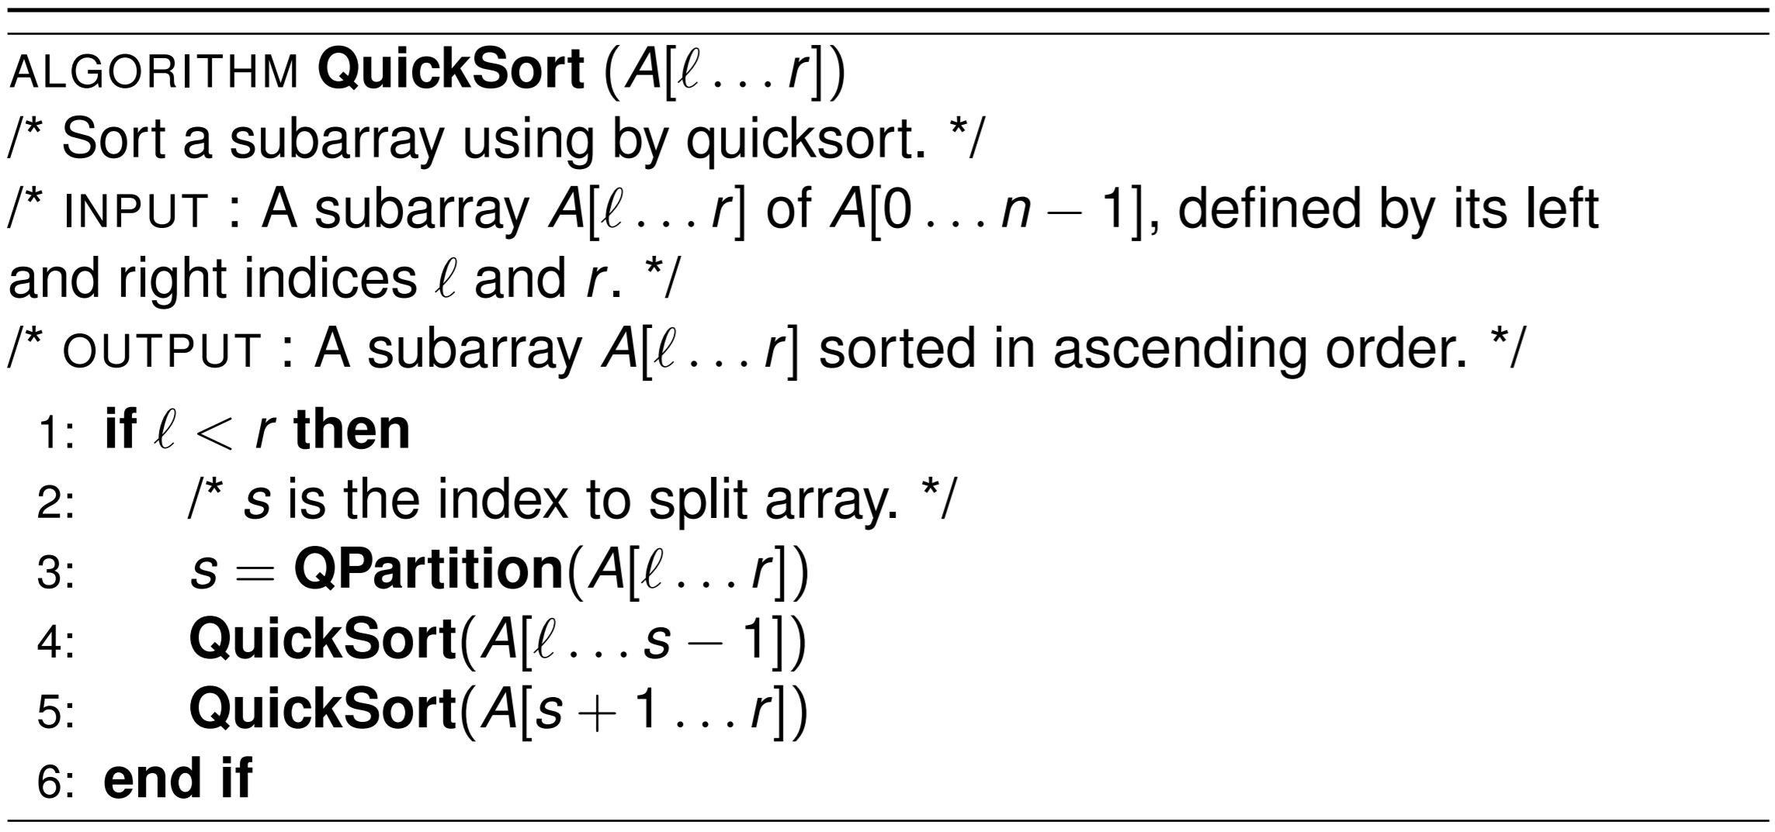
Quick Sort Algorithm

Slide 45
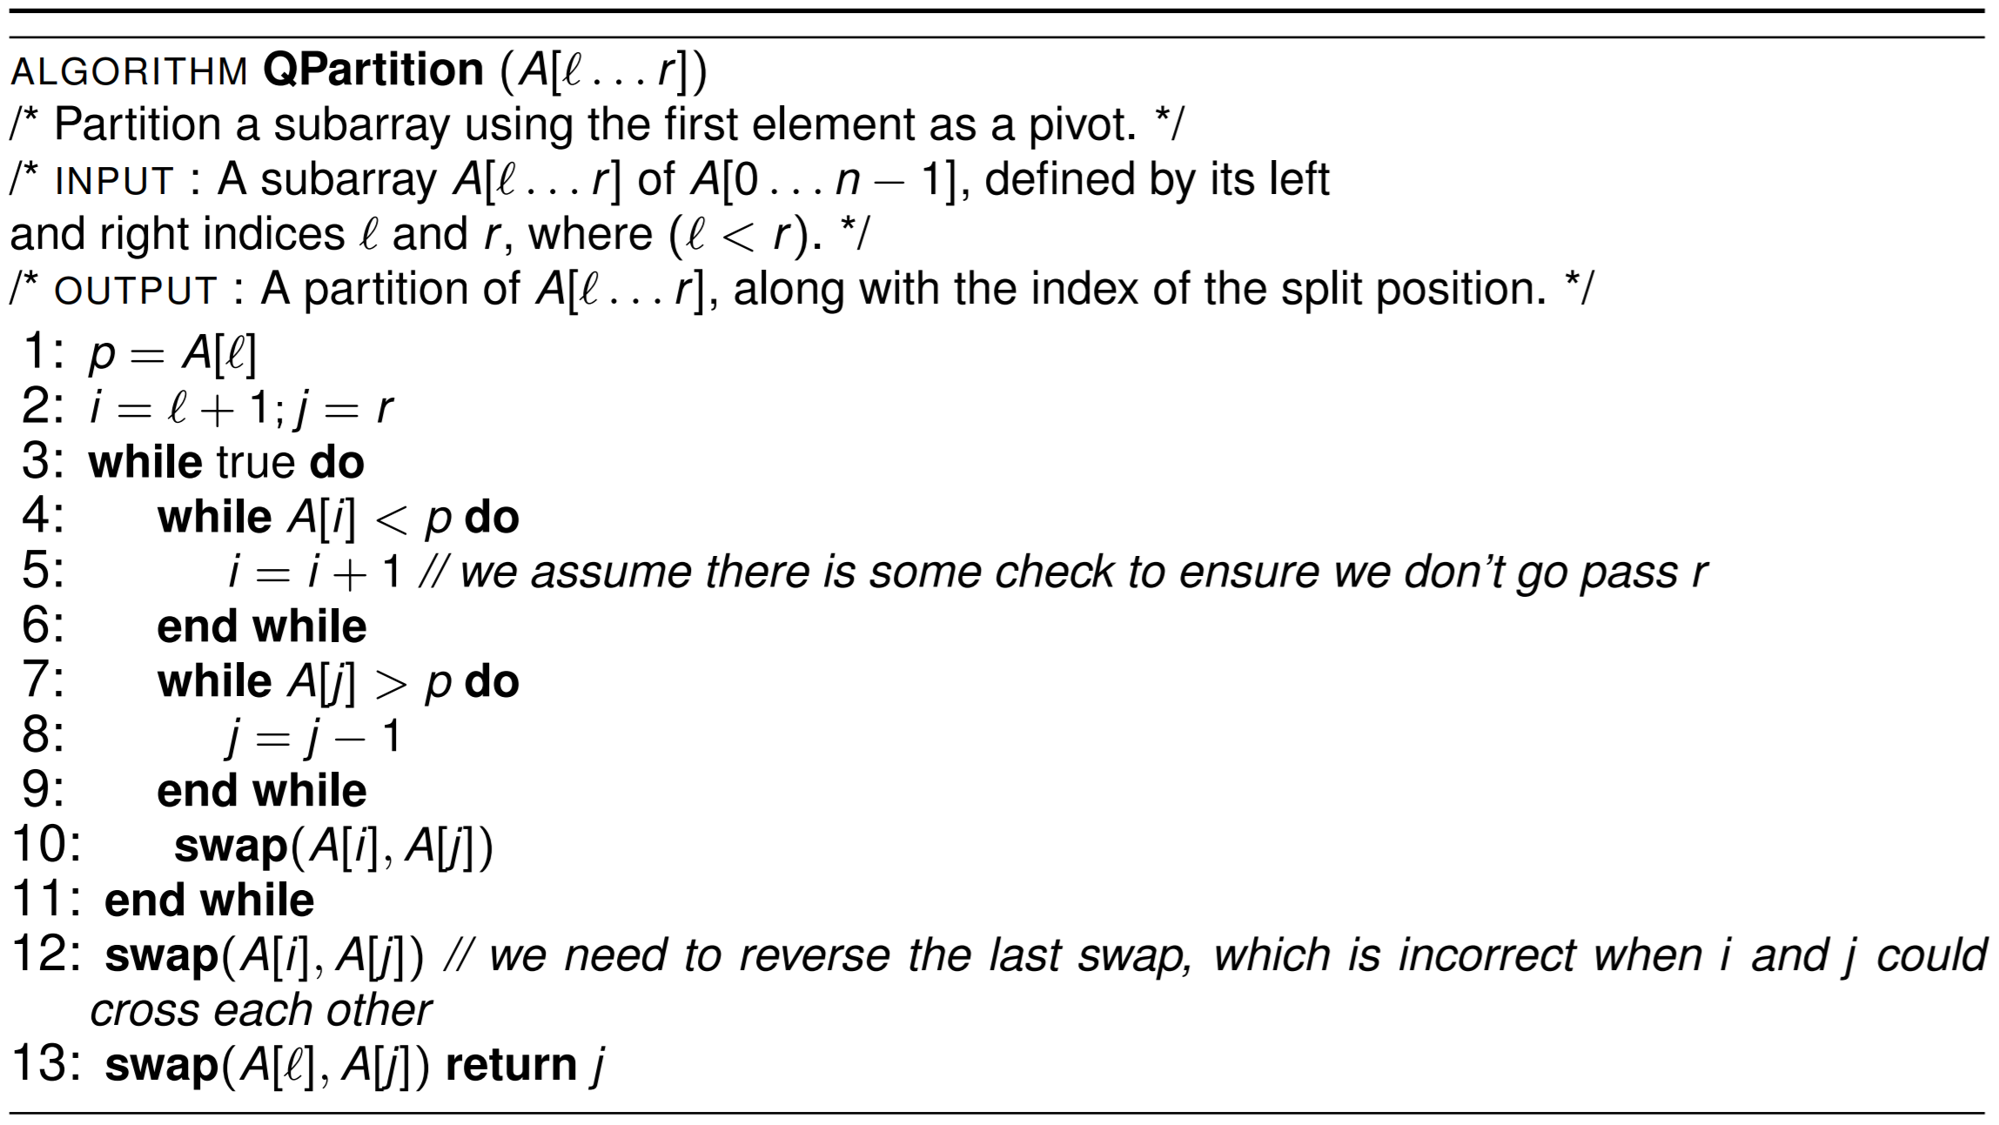
Quick Sort Algorithm

Slide 46
Quick Sort Example
Compares
Swaps
15
21
1
25
12
6
8
3
5
19
10
18
0
0

Slide 47
Quick Sort Example
i j
Compares
Swaps
15
21
1
25
12
6
8
3
5
19
10
18
1
0

Slide 48
Quick Sort Example
i j
Compares
Swaps
15
21
1
25
12
6
8
3
5
19
10
18
2
0

Slide 49
Quick Sort Example
i j
Compares
Swaps
15
21
1
25
12
6
8
3
5
19
10
18
3
0

Slide 50
Quick Sort Example
i j
Compares
Swaps
15
21
1
25
12
6
8
3
5
19
10
18
3
0

Slide 51
Quick Sort Example
i j
Compares
Swaps
15
10
1
25
12
6
8
3
5
19
21
18
3
1

Slide 52
Quick Sort Example
i j
Compares
Swaps
15
10
1
25
12
6
8
3
5
19
21
18
4
1

Slide 53
Quick Sort Example
i j
Compares
Swaps
15
10
1
25
12
6
8
3
5
19
21
18
5
1

Slide 54
Quick Sort Example
i j
Compares
Swaps
15
10
1
25
12
6
8
3
5
19
21
18
6
1

Slide 55
Quick Sort Example
i j
Compares
Swaps
15
10
1
25
12
6
8
3
5
19
21
18
7
1

Slide 56
Quick Sort Example
i j
Compares
Swaps
15
10
1
25
12
6
8
3
5
19
21
18
8
1

Slide 57
Quick Sort Example
i j
Compares
Swaps
15
10
1
25
12
6
8
3
5
19
21
18
9
1

Slide 58
Quick Sort Example
i j
Compares
Swaps
15
10
1
25
12
6
8
3
5
19
21
18
9
1

Slide 59
Quick Sort Example
i j
Compares
Swaps
15
10
1
5
12
6
8
3
25
19
21
18
9
2

Slide 60
Quick Sort Example
i j
Compares
Swaps
15
10
1
5
12
6
8
3
25
19
21
18
10
2

Slide 61
Quick Sort Example
i j
Compares
Swaps
15
10
1
5
12
6
8
3
25
19
21
18
11
2

Slide 62
Quick Sort Example
i j
Compares
Swaps
15
10
1
5
12
6
8
3
25
19
21
18
12
2

Slide 63
Quick Sort Example
i j
Compares
Swaps
15
10
1
5
12
6
8
3
25
19
21
18
13
2

Slide 64
Quick Sort Example
i j
Compares
Swaps
15
10
1
5
12
6
8
3
25
19
21
18
14
2

Slide 65
Quick Sort Example
j
i
Compares
Swaps
15
10
1
5
12
6
8
3
25
19
21
18
16
2

Slide 66
Quick Sort Example
j i
Compares
Swaps
15
10
1
5
12
6
8
3
25
19
21
18
17
2

Slide 67
Quick Sort Example
j i
Compares
Swaps
15
10
1
5
12
6
8
3
25
19
21
18
17
4

Slide 68
Quick Sort Example
j i
Compares
Swaps
3
10
1
5
12
6
8
15
25
19
21
18
17
5

Slide 69
Quick Sort Example
Compares
Swaps
3
10
1
5
12
6
8
15
25
19
21
18
17
5

Slide 70
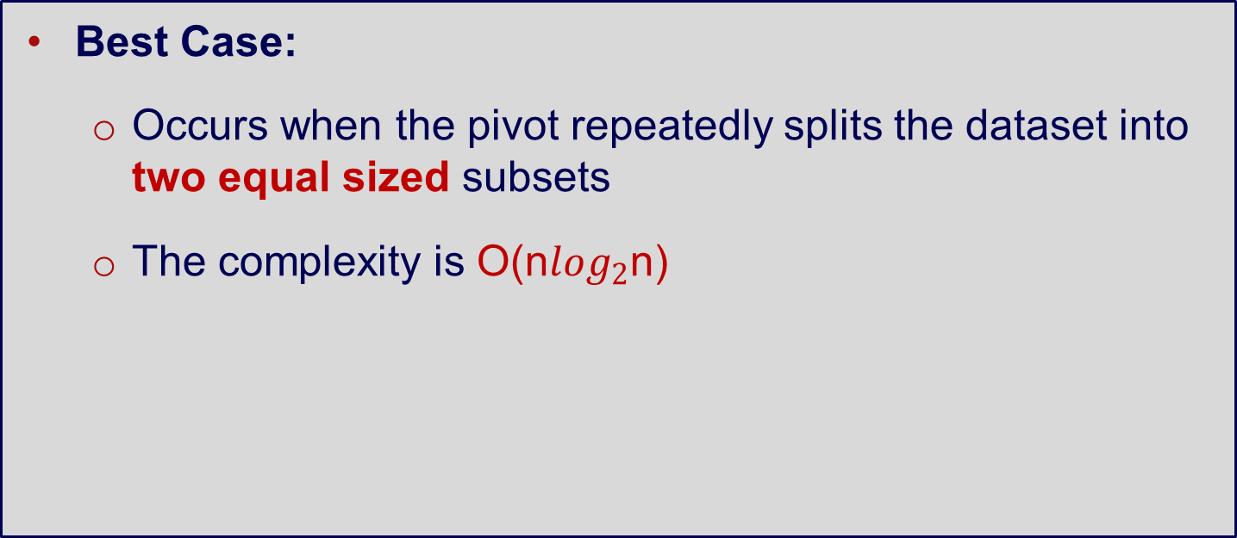
Quick Sort Complexity
Best Case:
Occurs when the pivot repeatedly splits the dataset into two equal sized subsets
The complexity is O(n$\log_{2}$n)

Slide 71
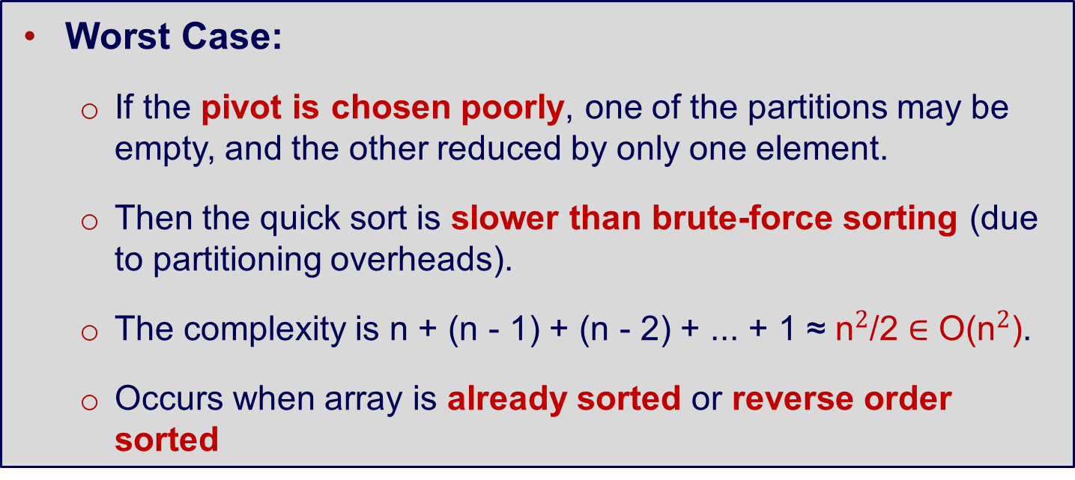
Quick Sort Complexity
Worst Case:
If the pivot is chosen poorly, one of the partitions may be empty, and the other reduced by only one element.
Then the quick sort is slower than brute-force sorting (due to partitioning overheads).
The complexity is n + (n - 1) + (n - 2) + ... + 1 ≈ ${\text{n}}^{2}$/2 ∈ O(${\text{n}}^{2}$).
Occurs when array is already sorted or reverse order sorted

Slide 72
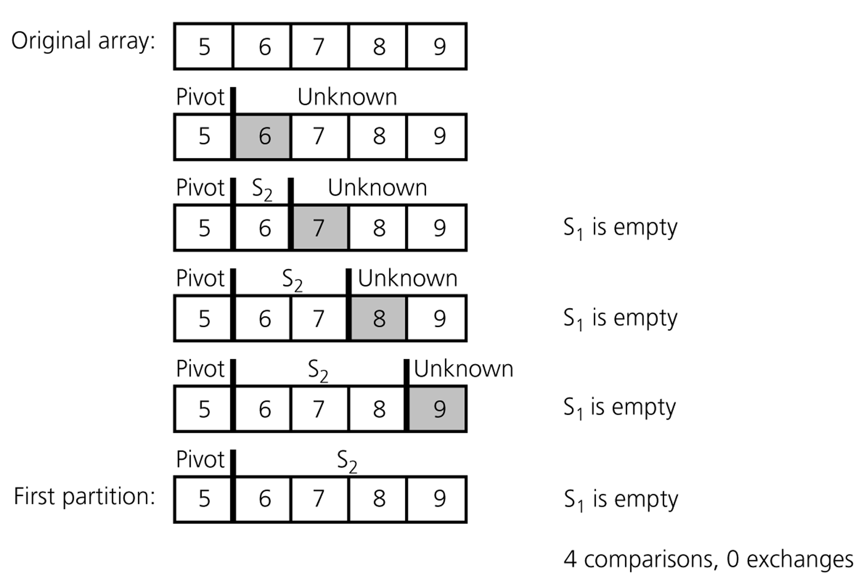
Quicksort – Analysis
A worst-case partitioning with quicksort

Slide 73
Quick Sort Complexity
Average case:
Number of comparisons C(n) ≈ 1.39*nlogn
That means 39% more comparisons than merge sort
But faster than merge sort in practice because of lower cost of other high-frequency operations,
and uses considerably less space (no need to copy to temporary arrays).

Slide 74
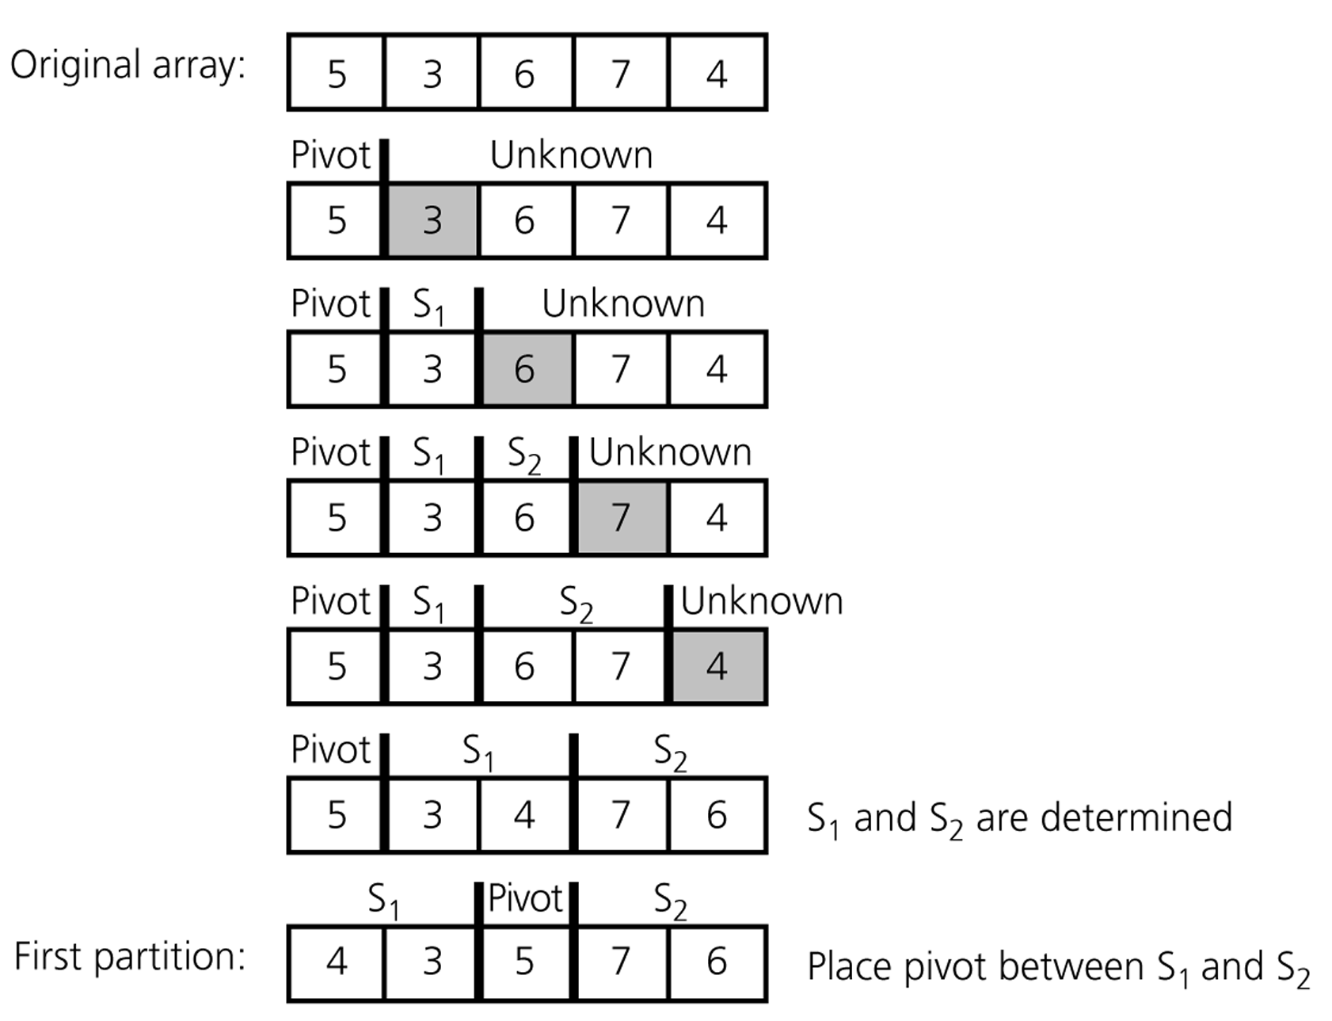
Quicksort – Analysis
An average-case partitioning with quicksort

Slide 75
Partition – Choosing the pivot
Which array item should be selected as pivot?
Somehow we have to select a pivot, and we hope that we will get a good partitioning
If the items in the array arranged randomly, we choose a pivot randomly
We can choose the first or last element as a pivot (it may not give a good partitioning)
We can use different techniques to select the pivot – for example the median.
Does this change the order of complexity?
What would be better, the median or the average?
What is the complexity of calculating the mean/median

Slide 76
Quick Sort – Pivots
Choosing a pivot:
First or last element: worst case appears for already sorted or reverse sorted arrays (as we saw last slide).
Median of three: requires extra compares but generally avoids worst case.
Random element: Poor cases are very unlikely, but efficient implementations can be non-trivial.
Notes:
The median of three has you look at the first, middle and last elements of the array, and choose the median of those three elements as the pivot.

Slide 77
Quick Sort – Pivots
As long as selected pivot is not always the worst case, Quick sort on average performs well.
For the curious: Watch the Google Talk:
“Three Beautiful Quick sorts” by Jon Bentley

Slide 78
Quicksort – Analysis
Quicksort is O(n*log₂n) in the best case and average case
Quicksort is O(n²) in the worst case, for example when the array is sorted and we choose the first element as the pivot
Although the worst case behavior is not so good, its average case behavior is much better than its worst case
So, Quicksort is one of best sorting algorithms using key comparisons

Slide 79
Quick Sort – Extra
Another implementation and good explanation for quick sort: http://me.dt.in.th/page/Quicksort/
Quick sort does sorting in place (no need for additional copying and temporary arrays).
Quick Sort is not a stable sorting method.

Slide 80
3. Convex Hull (again)

Slide 81
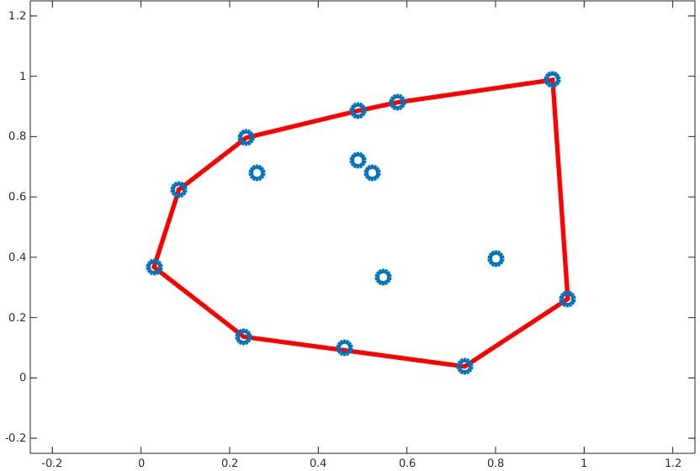
Convex Hull problem
The convex hull of a set of points is the smallest convex polygon that contains all the points, i.e., all the points are “within” the polygon.

Slide 82
Quick Hull algorithm
Recall: Brute force convex hull algorithm = compute lines between all pair of points then do comparison to see if points all fall on one side.
Can we use divide and conquer principles to design a faster algorithm?
Yes of course!

Slide 83
Quick Hull – Idea
Reduce the number of points that we have to consider for the boundary of the convex hull.
Use divide and conquer to (quickly) partition the set of points into possible and not possible boundary points.

Slide 84
Quick Hull – Idea
Sort all points in increasing order of x and then y.
Choose the leftmost and rightmost point. Call these points a and b.
Separate the remaining points into two sets S and T . All points above line ab are in S and all below are in T.
Find the point c in S which is farthest from line ab.
Discard all points inside the triangle abc.

Slide 85
Quick Hull – Idea
Put all points outside of ac in set Sj.
Put all points outside of bc in set Tj.
Run recursively on ac and bc.
Abort when the subset contains only the two endpoints of the current line.

Slide 86
Quick Hull – Example

Slide 87
Quick Hull – Example

Slide 88
Quick Hull – Example

Slide 89
Quick Hull – Example

Slide 90
Quick Hull – Example

Slide 91
Quick Hull – Example

Slide 92
Quick Hull – Example

Slide 93
Quick Hull – Example
www.algomation.com/algorithm/quick-hull-convex-hull

Slide 94
Quick Hull – Time Efficiency
Worst Case: O(n²) just as in quicksort.
Average Case: O(n) under reasonable assumptions about the distribution of points given (assuming points are sorted).
If the points are not initially sorted by x-coordinates, then the minimum cost is O(nlogn).
Several other O(nlogn) convex hull algorithms are known.

Slide 95
Wrapping things up

Slide 96
Summary
Introduced the divide-and-conquer algorithmic approach
Searching: rotated sorted arrays
Sorting: merge sort and quick sort
Convex hull by divide-and-conquer
Counting inversions

Slide 98
4. Counting Inversions

Slide 99
Recommender Systems
How can we make recommendations pertaining to matching music/movie preferences?
For example, if you like songs A, B, and C, and if I also like songs A and C, then the system will recommend song B to me
Divide and Conquer algorithms can provide a solution
By counting inversions

Slide 100
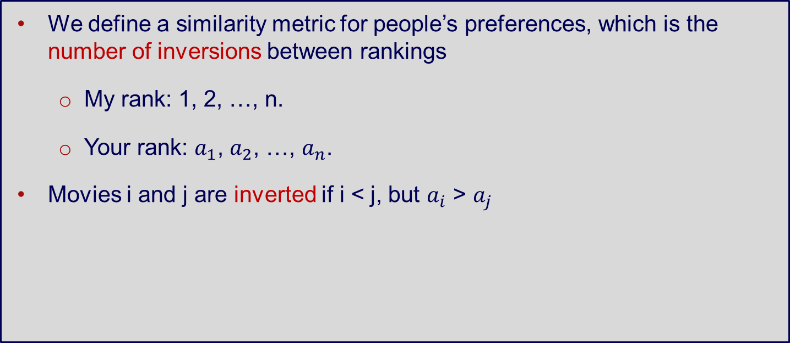
Counting Inversions
We define a similarity metric for people’s preferences, which is the number of inversions between rankings
My rank: 1, 2, …, n.
Your rank: $a_{1}$, $a_{2}$, …, $a_{n}$.
Movies i and j are inverted if i < j, but $a_{i}$ > $a_{j}$
 | Movie A | Movie B | Movie C | Movie D | Movie E
My rank | 1 | 2 | 3 | 4 | 5
Your rank | 1 | 3 | 4 | 2 | 5

Slide 101
Counting Inversions
Inversions: 3-2, 4-2 (two crossing points)
Can we solve this problem with a Brute Force approach?
 | Movie A | Movie B | Movie C | Movie D | Movie E
My rank | 1 | 2 | 3 | 4 | 5
Your rank | 1 | 3 | 4 | 2 | 5

Slide 102
Counting Inversions – Idea
Divide the list into two pieces
Recursively count the inversions in each half
Merge and count the inversions
At any merge step, the number of inversions will be [m – i]
Sum the total counts
→ Similar to Merge Sort
Notes:
https://www.youtube.com/watch?v=MxiQa22KrSQ
https://youtu.be/k9RQh21KrH8?t=377
135 246

Slide 103
Counting Inversions – Code
int mergeSort(int arr[], int temp[], int left, int right) {
int mid, inv_count = 0;
if (right > left) {
// Divide
mid = (right + left)/2;
// Inversion count will be the sum of inversions in left-part, right-part, and number of inversions in merging
inv_count = mergeSort(arr, temp, left, mid);
inv_count += mergeSort(arr, temp, mid+1, right);
// Merge
inv_count += merge(arr, temp, left, mid+1, right);
}
return inv_count;
}

Slide 104
Counting Inversions – Code
int merge(int arr[], int temp[], int left, int mid, int right) {
int i, j, k;
int inv_count = 0;
i = left; // i is index for left subarray
j = mid; // j is index for right subarray
k = left; // k is index for resultant merged subarray
while ((i <= mid – 1) && (j <= right)) {
if (arr[i] <= arr[j]) {
temp[k++] = arr[i++];
} else { // if left element is smaller than right → inversion
temp[k++] = arr[j++];
inv_count = inv_count + (mid – i);
}
}
[… to be continued]

Slide 105
Counting Inversions – Code
[… continued from previous code]
// copy the remaining elements of left subarray (if there are any) to temp
while (i <= mid – 1)
temp[k++] = arr[i++];
// copy the remaining elements of right subarray (if there are any) to temp
while (j <= right)
temp[k++] = arr[j++];
// copy back the merged elements from temp to original array
for (i = left; i <= right; i++)
arr[i] = temp[i];
return inv_count
}

Slide 106
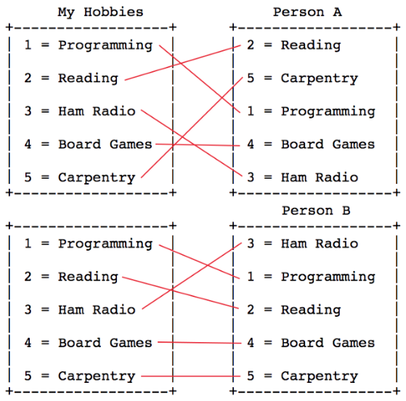
Counting Inversions
Who should I hang out with?
https://medium.com/@ssbothwell/counting-inversions-with-merge-sort-4d9910dc95f0

Slide 107
Counting Inversions – Applications
Compare similarities between ranked lists / Collaborative filtering
Check whether an array is sorted (i.e., inversions = 0) and how far it is from being sorted (i.e., reverse order will have inversions = maximum)
Nonparametric statistics (e.g., Kendall’s tau distance)

